Slide 1
SQL and Types of Commands
Pavan P

Slide 2
What is SQL ?
This database language is mainly designed for maintaining the data in relational database management systems. It is a special tool used by data professionals for handling structured data (data which is stored in the form of tables).

Slide 3
Why SQL is used ?
The basic use of SQL for data professionals and SQL users is to insert, update, and delete the data from the relational database.
SQL allows the data professionals and users to retrieve the data from the relational database management systems.
It also helps them to describe the structured data.
It allows SQL users to create, drop, and manipulate the database and its tables.
It also helps in creating the view, stored procedure, and functions in the relational database.
It allows you to define the data and modify that stored data in the relational database.
It also allows SQL users to set the permissions or constraints on table columns, views, and stored procedures.

Slide 4
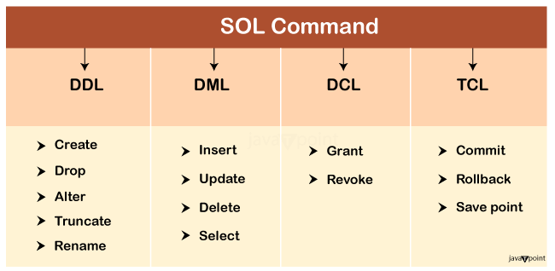
SQL Commands
SQL Command

Slide 5
1. Data Definition Language (DDL)
DDL changes the structure of the table like creating a table, deleting a table, altering a table, etc.
All the command of DDL are auto-committed that means it permanently save all the changes in the database.
Create
Alter
Drop
Truncate
Rename

Slide 6
2. Data Manipulation Language
DML commands are used to modify the database. It is responsible for all form of changes in the database.
The command of DML is not auto-committed that means it can't permanently save all the changes in the database. They can be rollback.
Insert
Update
Delete
Select

Slide 7
3. Data Control Language
DCL commands are used to grant and take back authority from any database user.
Following are the some commands that come under DCL:
Grant
Revoke

Slide 8
4. Transaction Control Language
Transactions are atomic i.e. either every statement succeeds or none of statement succeeds. There are number of Transaction Control statements available that allow us to control this behavior. These statements ensure data consistency. TCL commands can only use with DML commands like INSERT, DELETE and UPDATE only.
Commit
Rollback
Save point

